Slide 1
Data Structures in Python

Slide 2
Course Contents
Native Data Types
Strings
List
Tuple
Set
Dictionary

Slide 3
Native Data Types
Booleans are either True or False.
Numbers can be integers (1 and 2), floats (1.1 and 1.2), fractions (1/2 and 2/3), or even complex numbers.
Strings are sequences of Unicode characters, e.g. an html document.
Lists are ordered sequences of values.
Tuples are ordered, immutable sequences of values.
Sets are unordered bags of values.
Dictionaries are unordered bags of key-value pairs.
Bytes and byte arrays, e.g. a jpeg image file.

Slide 4
Immutable Types
Strings and Tuples are immutable, which means that once we create them, we can not change them.
The assignment operator (=) can make a variable point to strings or tuples just like simple data types: myString = “This is a test” myTuple = (1,45.8, True, “String Cheese”)‏
Strings & Tuples are both sequences, which mean that they consist of an ordered set of elements, with each element identified by an index.

Slide 5
String: Accessing Elements
>>> myString = “This is a test.”
We can access a specific element using an integer index which counts from the front of the sequence (starting at ZERO!)‏
myString[0] produces 'T'
myString[1] produces 'h'
myString[2] produces 'i'
myString[3] produces 's'
The len() function can be used to find the length of a sequence. Remember, the last element is the length minus 1, because counting starts at zero!
myString[ len(myString) – 1] produces '.'

Slide 6
Counting Backwards
>>> myString = “This is a test.”
As a short cut (to avoid writing len(myString) ) we can simply count from the end of the string using negative numbers:
myString[ len(myString) – 1 ] produces '.‘
myString[-1] also produces '.‘
myString[-2] produces 't‘
myString[-3] produces 's‘
myString[-4] produces 'e'

Slide 7
Index Out of Range!
>>> myString = “This is a test.”
If we try to access an element that does not exist, Python will throw an error! myString[5000] produces An ERROR! myString[-100] produces An ERROR!

Slide 8
Easy Traversals – The FOR Loop
Python makes traversals easy with a FOR loop:
for ELEMENT_VAR in SEQUENCE:
STATEMENT
A for loop automatically assigns each element in the sequence to the (programmer named) ELEMENT_VAR, and then executes the statements in the block of code following the for loop once for each element. for myVar in myString: if myVar == ‘T': print “I found a T!”
Note that it takes care of the indexing variable for us.

Slide 9
Grabbing Slices from a Sequence
The slice operator will clip out part of a sequence.
It looks a lot like the bracket operator, but with a colon that separates the “start” and “end” points.
SEQUENCE_VAR [ START : END : STEP]
myString = “This is a test.”
myString[0:2] produces 'Th' (0, 1, but NOT 2)‏
myString[3:6] produces 's i” (3-5, but NOT 6)‏
myString[3:9:2] produces 'si ” (3-5-7)‏
Quick QUIZ:
myString[ 1 : 4 ] produces ?
myString[ 5: 7 ] produces ?

Slide 10
Slices – Default Values for Blanks
>>> myString = “This is a test.”
If you leave the “start” part blank, it assumes you want zero.
myString[ : 2] produces 'Th' (0,1, but NOT 2)‏
myString[ : 6] produces 'This i' (0-5, but NOT 6)‏
myString[ : 6:2] produces 'Ti ' (0-2-4)‏
If you leave the “end” blank, it assumes you want until the end of the string
myString[ 5 : ] produces 'is a test.' (5 – end)‏
myString [ : ] produces 'This is a test.' (0-end)‏
myString[: : -1] produces reverse of string.

Slide 11
List
A list is a data structure that holds an ordered collection of items i.e. you can store a sequence of items in a list.
The list of items should be enclosed in square brackets so that Python understands that you are specifying a list.
Once you have created a list, you can add, remove or search for items in the list.
Since we can add and remove items, we say that a list is a mutable data type i.e. this type can be altered.

Slide 12
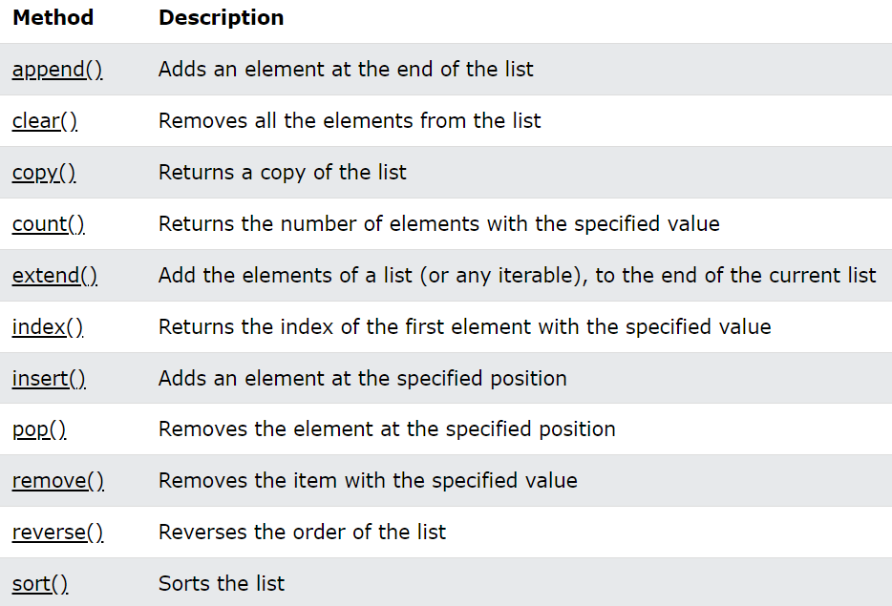

Slide 13
Quick Introduction To Objects And Classes
When we use a variable i and assign a value to it, say integer 5 to it, you can think of it as creating an object (i.e. instance) i of class (i.e. type) int .
A class can also have methods i.e. functions defined for use with respect to that class only. You can use these pieces of functionality only when you have an object of that class. e.g. Python provides an append method for the list class which allows you to add an item to the end of the list.
A class can also have fields which are nothing but variables defined for use with respect to that class only. You can use these variables/names only when you have an object of that class.
Fields are also accessed by the dotted notation, for example, mylist.field .

Slide 14
Tuple
Tuples are used to hold together multiple objects. Think of them as similar to lists, but without the extensive functionality that the list class gives you.
One major feature of tuples is that they are immutable i.e. you cannot modify tuples.
Tuples are defined by specifying items separated by commas within an optional pair of parentheses.
Tuples are usually used in cases where a statement or a user-defined function can safely assume that the collection of values i.e. the tuple of values used will not change.

Slide 15
Sets
Sets are used to store multiple items in a single variable.
A set is a collection which is unordered, unchangeable*, and unindexed.
Indentified by curly braces
>>> X= {'Alice', 'Bob', 'Carol'}
>>> print(x)
>>> print(type(x))
{'Dean'} is a singleton
Can only contain unique elements
Duplicates are eliminated
>>> cset = {11, 11, 22}
>>> print(cset) {11, 22}
Immutable like tuples and strings

Slide 16
Sets
Union Operation
>>> aset = {11, 22, 33}
>>> aset = aset | {55}
>>> print(aset) {33, 11, 22, 55}
Sets Have No Order
>>> print( {1, 2, 3, 4, 5, 6, 7}) {1, 2, 3, 4, 5, 6, 7}
>>>print( {11, 22, 33}) {33, 11, 22}

Slide 17
Sets Do Not Support Indexing
>>> myset = {'Apples', 'Bananas', 'Oranges'}
>>> print(myset) {'Bananas', 'Oranges', 'Apples'}
>>> print(myset[0]) Traceback (most recent call last): File "<pyshell#2>", line 1, in <module> myset[0] TypeError: 'set' object does not support indexing

Slide 18
Boolean Operations on Sets
>>> aset = {11, 22, 33}
>>> bset = {12, 23, 33}
Union of two sets
>>> print(aset | bset ) {33, 22, 23, 11, 12}
Intersection of two sets:
>>> print(aset & bset ) {33}
Difference:
>>>print( aset – bset ) {11, 22}
Symmetric difference:
>>>print( aset ^ bset ) {11, 12, 22, 23}

Slide 19
Access Items
You cannot access items in a set by referring to an index or a key.
But you can loop through the set items using a for loop, or ask if a specified value is present in a set, by using the in keyword.
Example
Loop through the set, and print the values:
thisset = {"apple", "banana", "cherry"} for x in thisset: print(x)
thisset = {"apple", "banana", "cherry"}
print("banana" in thisset)

Slide 20
Add Items
Once a set is created, you cannot change its items, but you can add new items.
To add one item to a set use the add() method.
Example
Add an item to a set, using the add() method:
thisset = {"apple", "banana", "cherry"} thisset.add("orange") print(thisset)
Add Sets
To add items from another set into the current set, use the update() method.
Example
Add elements from tropical into thisset:
thisset = {"apple", "banana", "cherry"} tropical = {"pineapple", "mango", "papaya"} thisset.update(tropical) print(thisset)

Slide 21
Remove Item
To remove an item in a set, use the remove()
Example
Remove "banana" by using the remove() method:
thisset = {"apple", "banana", "cherry"} thisset.remove("banana") print(thisset)
Remove a random item by using the pop() method:
thisset = {"apple", "banana", "cherry"} x = thisset.pop() print(x) print(thisset)

Slide 22
The clear() method empties the set:
thisset = {"apple", "banana", "cherry"} thisset.clear() print(thisset)
The del keyword will delete the set completely:
thisset = {"apple", "banana", "cherry"} del thisset print(thisset)

Slide 23
Join Two Sets
There are several ways to join two or more sets in Python.
You can use the union() method that returns a new set containing all items from both sets, or the update() method that
inserts all the items from one set into another:
Example
The union() method returns a new set with all items from both sets:
set1 = {"a", "b" , "c"} set2 = {1, 2, 3} set3 = set1.union(set2) print(set3)

Slide 24
Example
Return a set that contains the items that exist in both set x, and set y:
x = {"apple", "banana", "cherry"} y = {"google", "microsoft", "apple"} z = x.intersection(y) print(z)
Python Set intersection() Method
❮ Set Methods
Python Set difference() Method
Return a set that contains the items that only exist in set x, and not in set y:
x = {"apple", "banana", "cherry"} y = {"google", "microsoft", "apple"} z = x.difference(y) print(z)

Slide 25
Python Set symmetric_difference() Method
Return a set that contains all items from both sets, except items that are present in both sets:
x = {"apple", "banana", "cherry"} y = {"google", "microsoft", "apple"} z = x.symmetric_difference(y) print(z)

Slide 26


Dictionary
A dictionary is like an address-book where you can find the address or contact details of a person by knowing only his/her name i.e. we associate keys (name) with values (details).
Note that the key must be unique just like you cannot find out the correct information if you have two persons with the exact same name.
One can use only immutable objects (like strings) for the keys of a dictionary but can use either immutable or mutable objects for the values of the dictionary.
This basically translates to say that you should use only simple objects for keys.

Slide 27
Dictionary
Pairs of keys and values are specified in a dictionary by using the notation
d = {key1 : value1, key2 : value2 }
Notice that the key-value pairs are separated by a colon and the pairs are separated themselves by commas and all this is enclosed in a pair of curly braces.
Remember that key-value pairs in a dictionary are not ordered in any manner. If you want a particular order, then you will have to sort them yourself before using it.
The dictionaries that we will be using are instances/objects of the dict class.

